Slide 1






DS 310
FINAL PROJECT
POLICIES FOR COVID-19 MITIGATION
TEAM 1
TEAM 1 – DATA WARRIORS

Slide 4
JINANSHI MEHTA
DANNY FOLEY
BEN FRECHETTE
JASON HUANG
ANIA SHAHEED
NASER SALAS

Slide 5
JINANSHI MEHTA
DANNY FOLEY
BEN FRECHETTE
JASON HUANG
ANIA SHAHEED
NASER SALAS

Slide 6







THE DATA WARRIORS
JINANSHI MEHTA
DANNY FOLEY
BEN FRECHETTE
JASON HUANG
ANIA SHAHEED
NASER SALAS
DATA ENGINEERS
DATA ANALYSTS

Slide 7



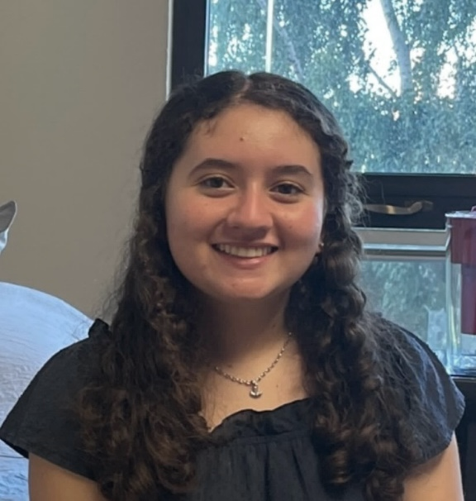

THE DATA WARRIORS

Slide 9
Objectives:
Challenge 1 – extract and load data into Azure storage
Challenge 2 – construct data flow to organize ODS
Challenge 3 – create external tables within Azure Synapse
Challenge 4 – analysis and reporting
Load external tables into PowerBI
Create dashboards comparing policies
Select most effective policies
OVERVIEW

Slide 10
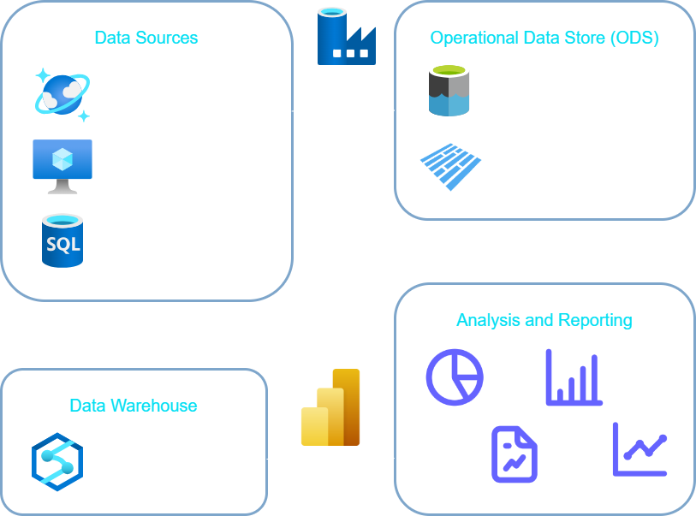
OVERVIEW

Slide 11
POLICIES
Assigned policies
Schools closing (1)
International travel ban arrivals from some regions (3)
Selected policies
Workplace closing – require closing (2)
Stay at home requirements (2)

Slide 12

THANKS FOR
LISTENING

